Slide 1
CSE 109 Electrical Circuits
Dr. Md. Forkan Uddin
Associate Professor
Department of Electrical and Electronic Engineering (EEE)
Bangladesh University of Engineering and Technology (BUET)

Slide 2
Course Objectives
Basic course of Electrical Engineering
All the Engineers and Architectures need to know the basics of electrical engineering
Architectures and civil engineers must know how the electrical circuit go through a building and how much space is needed for wiring
Mechanical engineers must know electrical engineering basics to design machines and industrial tools and equipments
Computer engineers deals with computer, communication equipments, and develop different protocols, logic circuits and algorithms
To effectively design the logic, protocol, and algorithm, the knowledge of electrical and electronic engineering is necessary
The objective is to provide the basic knowledge of Electrical Engineering such that electronic engineering, VLSI design, Electronic logic design courses can be understood

Slide 3
Books
Text Book:
Fundamentals of Electrical Circuits - C. Alexander and M. Sadiku
Alternating-current circuits- Russell Marion Kerchner and George Francis Corcoran

Slide 4
Assessment
Mid Term I : 15%
Mid Term II : 15%
Final: 25%
Quiz/Class test: 15%
Attendance: 5%
Lab: 25%
Total 100%

Slide 5
Basic Concepts

Slide 6
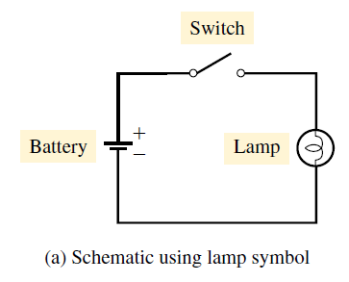
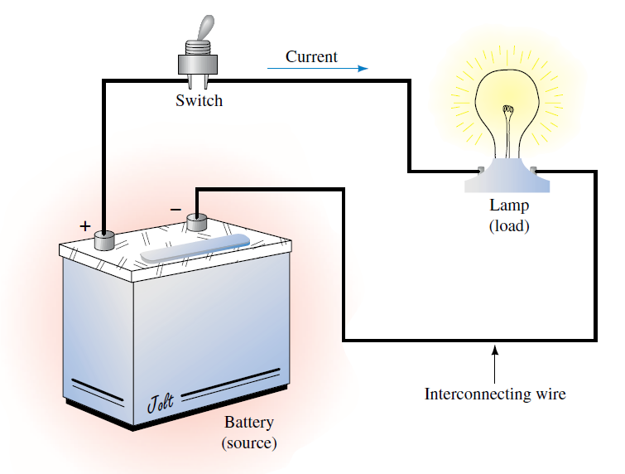
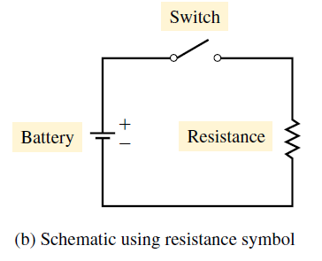
Introduction
An electric circuit is an interconnection of electrical elements

Slide 7
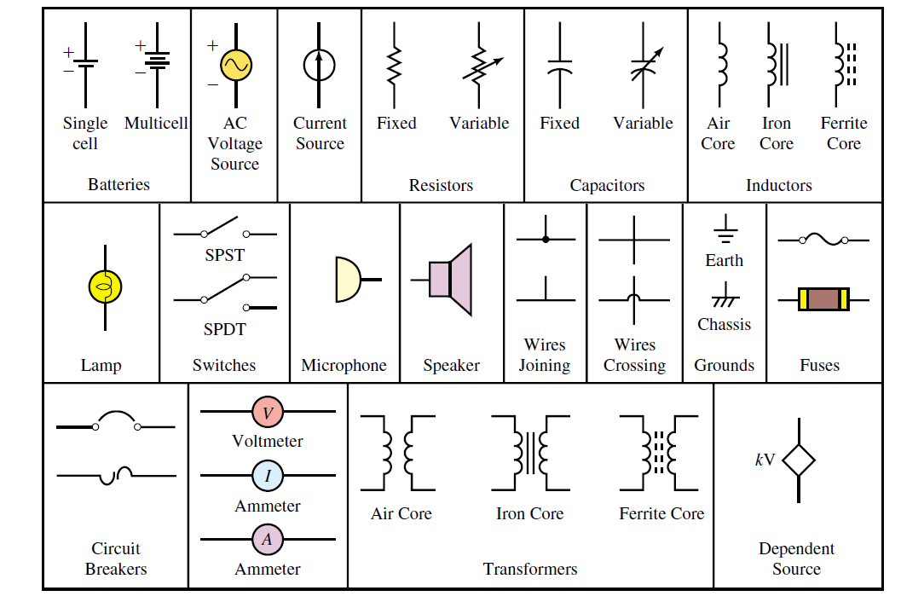
Symbols of Electrical Elements
Two types of Elements:
Active elements: Can generate energy – Generators, Batteries, Operational amplifiers
Passive elements: Not capable to generate energy – Resistor, Capacitor, Inductor

Slide 8
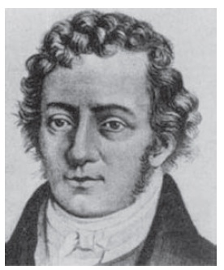
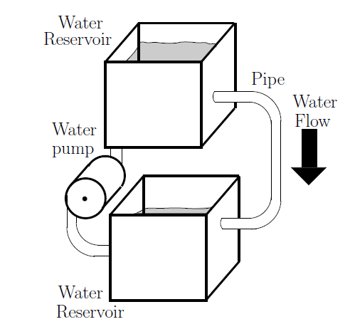
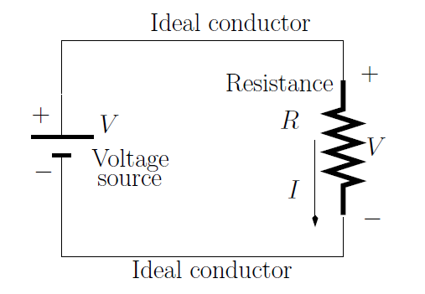
What is Current?
Andre Marie Ampere (1775–1836): a French mathematician and physicist defined the electric current and developed a way to measure it.
Hydraulic equivalent system
Current is actually the rate of flow (or rate of movement) of charge

Slide 9
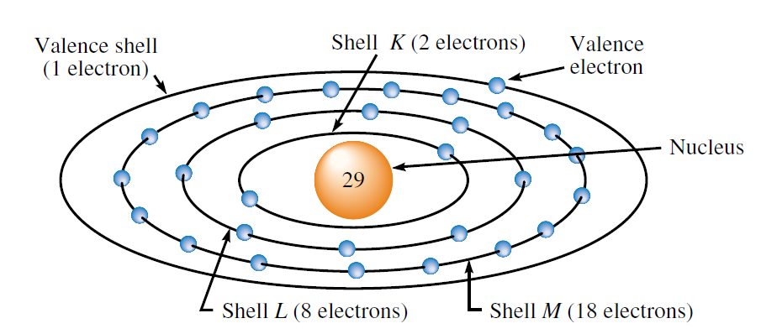
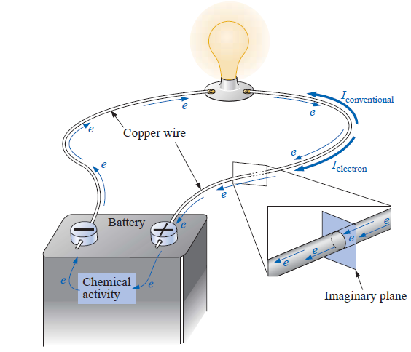
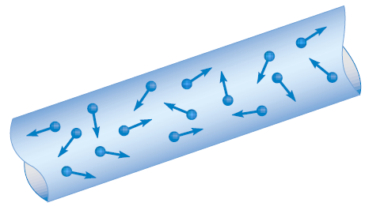
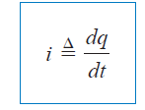
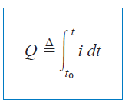

What is Current?
Copper atom:
The valence electron is loosely bound
In copper, there are of the order of 10²³ free electrons per cubic centimeter at room temperature
Random motion of free electrons in a conductor
Current is actually the rate of flow (or rate of movement) of charge
q in Coulombs
t in seconds
I in amperes

Slide 10
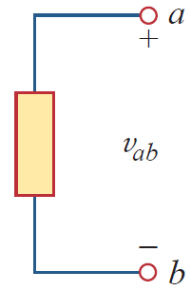
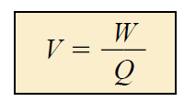
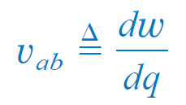
What is Voltage?
Voltage (or potential difference) is the energy required to move a unit charge through an element, measured in volts (V)
w is energy in joules
q is charge in coulombs
v is the voltage in volts
By definition, the voltage between two points is one volt if it requires one joule of energy to move one coulomb of charge from one point to the other.
Note:
Voltage is defined between points.
For the case of the battery, for example, voltage appears between its terminals.
Thus, voltage does not exist at a point by itself; it is always determined with respect to some other point. For this reason, voltage is also called potential difference.

Slide 11
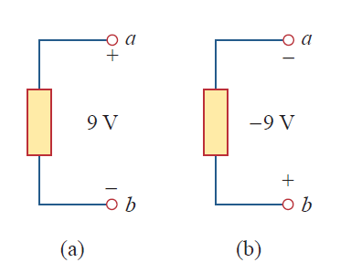

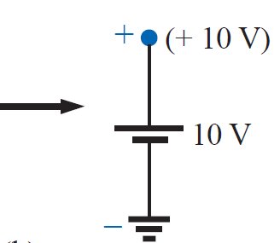

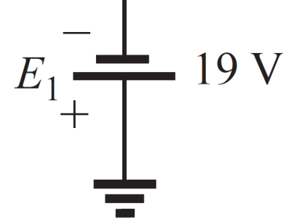


Voltage and Ground
V_{ab} = V_{a} – V_{b} = - V_{ba}
The voltage V_{ab} between two points a and b is the energy (or work) needed to move a unit charge from a to b
V_{a}: Potential of point a with respect to ground (0 V)
- 19 V

Slide 12
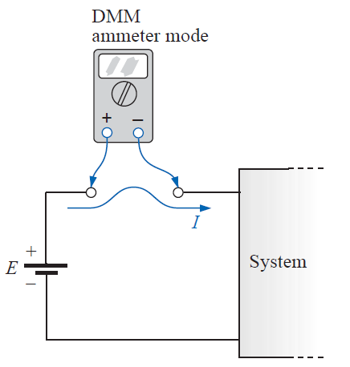
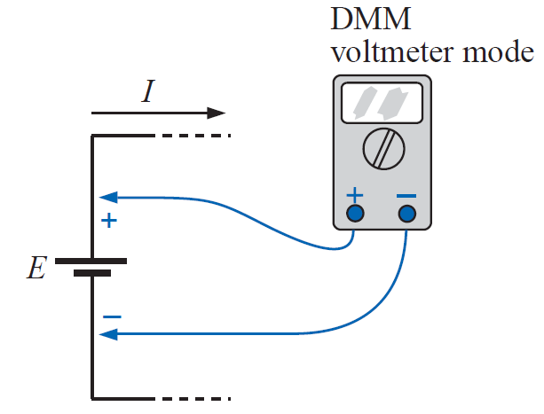
Voltage and Current
Remember:
Electric current is always through an element
An electric voltage is always across the element or between two points

Slide 13
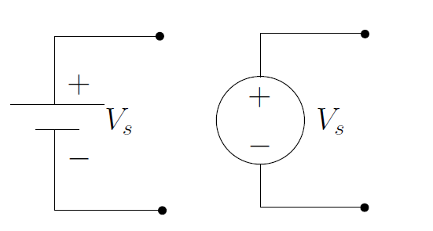
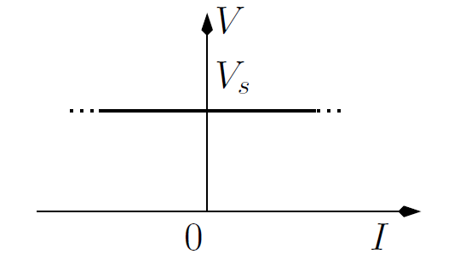
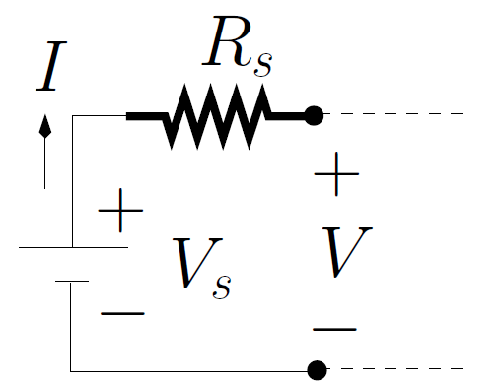
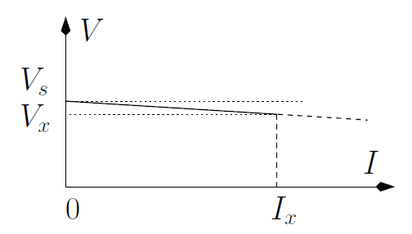
Independent Voltage Source
Ideal Voltage Source
V – I characteristic
Practical Voltage Source
V – I characteristic

Slide 14
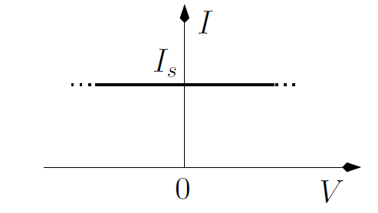
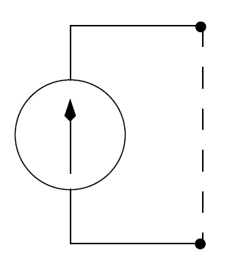
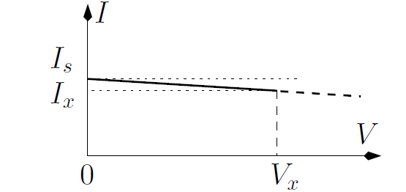
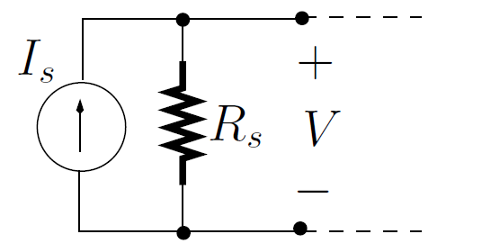
Independent Current Source
Ideal Current Source
I – V characteristic
Practical Current Source
I – V characteristic

Slide 15
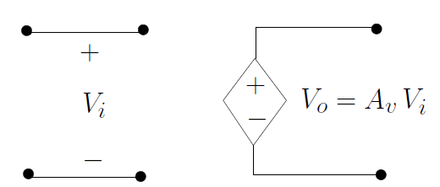
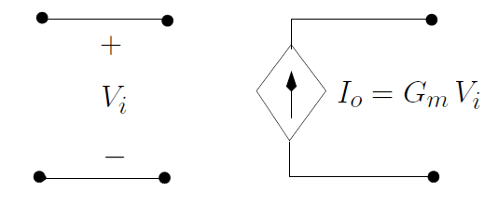
Dependent Sources
A dependent source is an active element in which the source quantity is controlled by another voltage or current
Voltage-controlled voltage source
Voltage-controlled current source

Slide 16
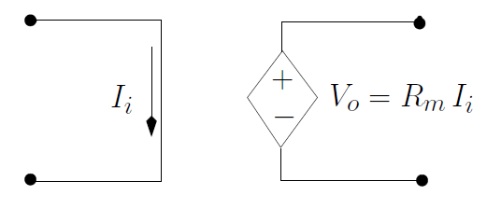
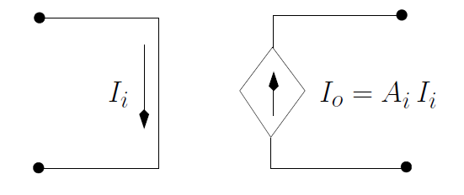
Sources
Current-controlled voltage source
Current-controlled current source

Slide 17
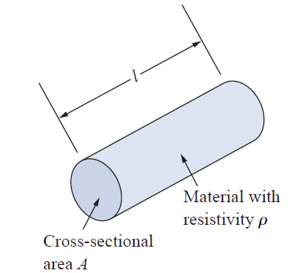
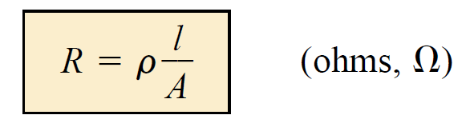
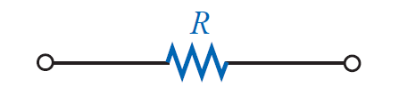
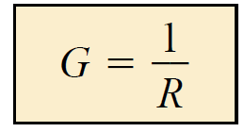
Resistance and Conductance
Resistance
Symbol and notation
Conductance

Slide 18
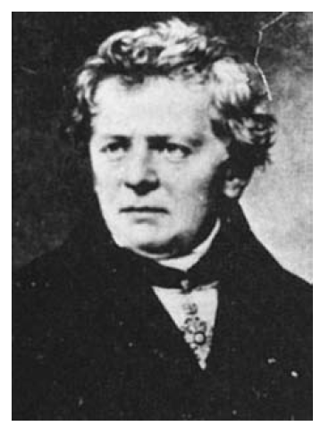
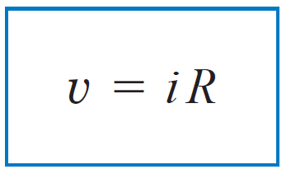

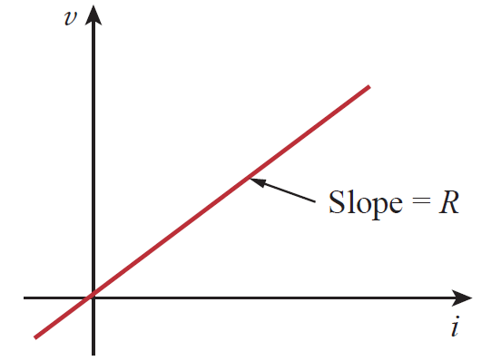
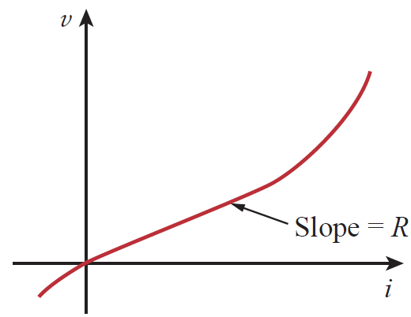
Ohm’s Law
Ohm’s law
voltage V across a resistor R is directly proportional to the current I flowing through the resistor
Georg Simon Ohm (1787–1854), a German physicist, in 1826
experimentally determined this basic law relating voltage and current for a resistor. Ohm’s work was initially denied by critics.
Linear resistor: Obeys Ohm’s law
Non-linear resistor: Does not obey Ohm’s law

Slide 19
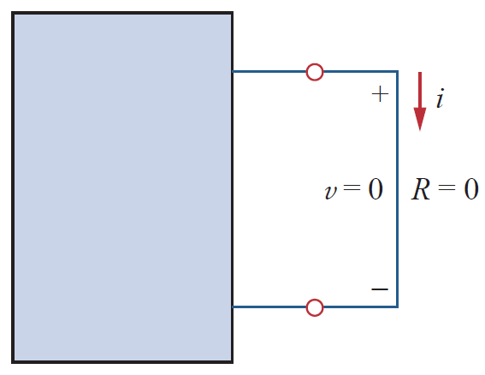

Short Circuit
A short circuit is a circuit element with resistance approaching zero (i.e., R = 0)
A short circuit can carry a current of a level determined by the external circuit, but the potential difference (voltage) across its terminals is always zero volts

Slide 20
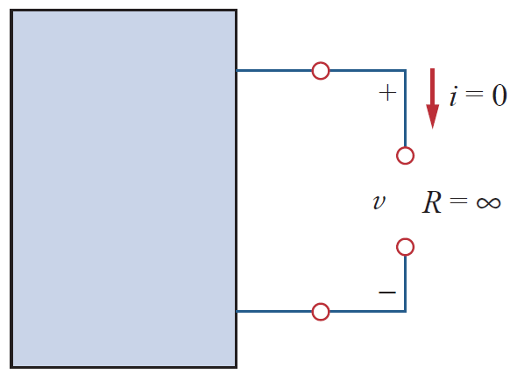
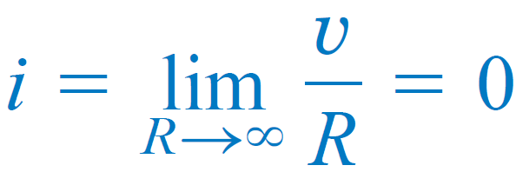
Open Circuit
An open circuit is a circuit element with resistance approaching infinity (i.e., R = ∞)
An open circuit can have a potential difference (voltage) across its terminals, but the current is always zero amperes

Slide 21
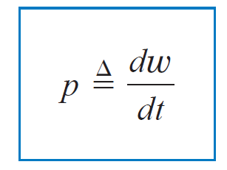
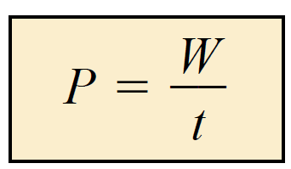
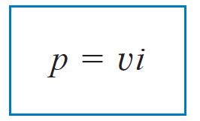
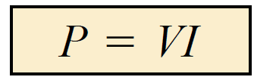
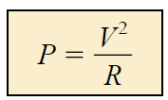

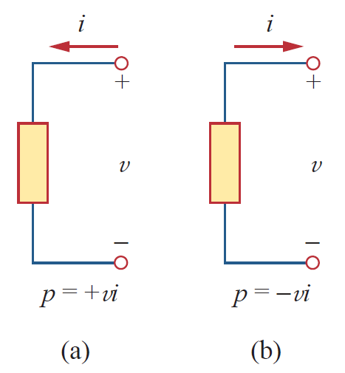
Power
Power is the time rate of expending or absorbing energy
Unit: watts (W)
In terms of voltage and current:
Passive sign convention:
When the current enters through the positive terminal of an element, power is absorbed (Fig. a): p = vi
If the current enters through the negative terminal, power is delivered (Fig. b): p = - vi
NOTE: If you “explicitly” write “power delivered”, then do not use ‘-’ (negative) sign (follow the convention of Boylestad)

Slide 22
Summary
Circuit elements
Dependent and independent sources
Current
Voltage
Power
Power sign convention
Ohm’s law
Reading
Boylestad - Chapter 2, 3, 4

